Slide 1



Montlake Consulting Group

Slide 2
Montlake Consulting Group
Partner: Venkat Rao
Managers: Connor Bogin
Felicia Widjaja
Consultants: Steve Bass
Tomer Benami
Johnny Chan
Geoff Coyner
Peter Fantham
Mike Furgason
Sugu Venkat

Slide 3
TASK
Develop a competitive matrix of mobile carriers and operating systems
Analyze app trends and consumption profile
Consider future forecasts in the mobile industry
Propose feasible recommendations
Montlake Consulting Group

Slide 4
Carriers
Montlake Consulting Group

Slide 5
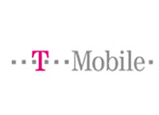

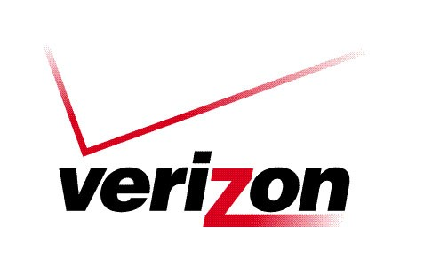
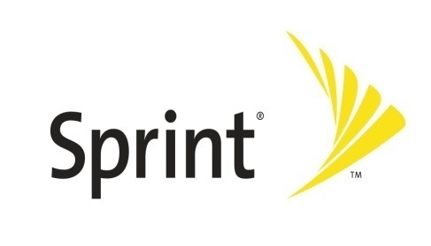
Research Highlights
Carriers
Carriers:
Verizon
AT&T
T-Mobile
Sprint
Overview
Carriers
OS
Apps
Analysis
Proposal
Montlake Consulting Group

Slide 6
Market Shares
 | T-Mobile | AT&T | Verizon | Sprint
Market Share | 13% | 32% | 35% | 20%
Total Subscribers | 33,497,000 | 79,600,000 | 87,700,000 | 48,826,000
Subscriber Growth | 1% | 1.70% | 1.30% | -0.50%
3G Subscribers | 950,000 | 19,101,600 | 30,600,000 | 14,000,000
3G Subscriber Growth | 8.60% | 9.60% | 1.70% | 2%
Churn (Postpaid) | 2.30% | 1.20% | 1.14% | 2.25%
 |  |  | Industry-low churn (14 quarters in a row)
Overview
Carriers
OS
Apps
Analysis
Proposal
* Mmetrics
* Industry Interview
Montlake Consulting Group

Slide 7
Type of Customers
T-Mobile | AT&T | Verizon | Sprint
Young customers (18-25) who want low prices and high value Older mobile minimalists, who tend not to like or use the extra features of a mobile phone. They value low price, high reliability, and good customer service. | Markets to families and tech savvy 25-40 year olds with disposable income. Pushes high tech devices and emphasizes strong coverage with “more bars in more places”. Focuses on business accounts separately. | Focuses on people who are always on the go. Emphasizes its marketing campaigns around the ability to offer the largest network coverage. A general provider trying to maximize quantity of subscriptions. | Primary is the business community. Additionally, individual users who value speed and efficiency (with the direct connect technology).
Overview
Carriers
OS
Apps
Analysis
Proposal
Montlake Consulting Group
* Analysis of Marketing

Slide 8

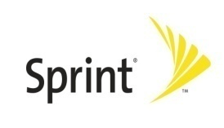
Summary - Carriers
Growth
Market Share
Target Market
Demographics
Churn
Coverage Rep
Overview
Carriers
OS
Apps
Analysis
Proposal
Montlake Consulting Group

Slide 9
Operating Systems
Montlake Consulting Group

Slide 10



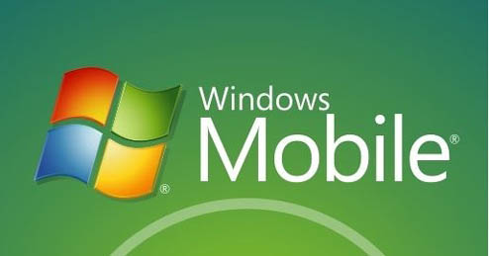
Research Highlights
Operating Systems
Carriers:
Verizon
AT&T
T-Mobile
Sprint
Carriers
OS
Apps
Analysis
Proposal
Montlake Consulting Group

Slide 11
Global Market Share
2012 Opportunity Forecast: 522 million units worldwide
Platform | Unit Sales (M) | 4Q/12 Share | 1Q/09 Share | Difference
Symbian | 203.58 | 39.00% | 49.30% | -10.30%
Android | 75.69 | 14.50% | 1.60% | 12.90%
iPhone | 71.51 | 13.70% | 10.80% | 2.90%
WinMo | 66.82 | 12.80% | 10.30% | 2.50%
BlackBerry | 65.25 | 12.50% | 19.90% | -7.40%
Linux | 28.19 | 5.40% | 7.00% | -1.60%
Palm | 10.96 | 2.10% | 0.00% | 2.10%
Carriers
OS
Apps
Analysis
Proposal
Montlake Consulting Group
* Gartner

Slide 12
Domestic Market Share
2014 Opportunity Forecast: 93 million units
Carriers
OS
Apps
Analysis
Proposal
Montlake Consulting Group
* Frost and Sullivan

Slide 13
Domestic Market Share Growth
Carriers
OS
Apps
Analysis
Proposal
Montlake Consulting Group
* Frost and Sullivan

Slide 14
Type of Customers
iPhone | Android | RIM | WinMo
Users who want high app availability and a seamless media experience. Higher disposable income. | Desire having carrier options Value availability and diversity of apps Lower disposable income | Primarily enterprise users and family members of those users. Value efficiency and management software. | Began as an OS geared towards the enterprise experience. Have lost the its market share due to office suite availability on other OS’s.
Carriers
OS
Apps
Analysis
Proposal
Montlake Consulting Group
* Analysis of Marketing

Slide 15
Satisfaction
iPhone tops consumer satisfaction survey
Android is a close second
Lacks the customer-oriented functions to rival Android/iPhone
Windows Mobile and Symbian still run on majority of smartphones
More app downloads
More hardware issues
Carriers
OS
Apps
Analysis
Proposal
Montlake Consulting Group
*eMarketer

Slide 16
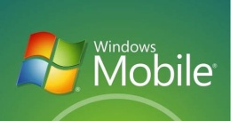
Summary - OS
Growth
Current Market Share
Satisfaction
Rhapsody Interest
App Competition
Carriers
OS
Apps
Analysis
Proposal
Montlake Consulting Group

Slide 17
Applications
Montlake Consulting Group

Slide 18
Make part of presentation
App Industry Trends
Carriers
OS
Apps
Analysis
Proposal
Montlake Consulting Group
* The Nielsen Company

Slide 19
Make part of presentation
App Industry Trends
Carriers
OS
Apps
Analysis
Proposal
Montlake Consulting Group
* CFI Group

Slide 20
Make part of presentation
App Industry Trends
Carriers
OS
Apps
Analysis
Proposal
Montlake Consulting Group
* AdMob

Slide 21
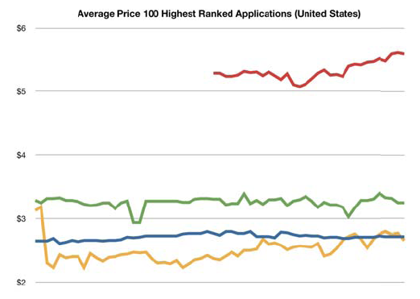
Make part of presentation
App Industry Trends
Average Price 100 Highest Ranked Apps (US)
$6
$5
Apple App Store
Android Mkt Games
$4
Android Mkt Apps
BlackBerry App World
$3
$2
Carriers
OS
Apps
Analysis
Proposal
Montlake Consulting Group
* Distimo

Slide 22
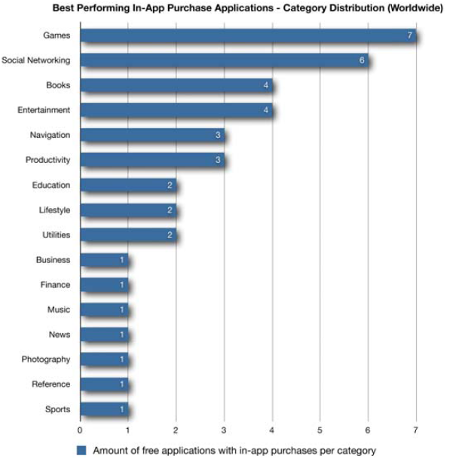
Make part of presentation
App Industry Trends
Games
Social Networking
Books
Entertainment
Navigation
Productivity
Education
Lifestyle
Utilities
Business
Finance
Music
News
Photography
Reference
Sports
Best Performing In-App Purchase Apps (Worldwide)
0 1 2 3 4 5 6 7
Carriers
OS
Apps
Analysis
Proposal
Montlake Consulting Group
* Distimo

Slide 23
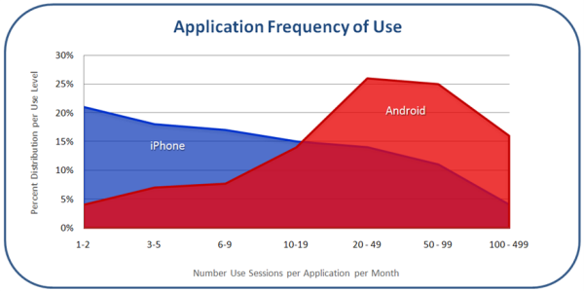
App Industry Trends
% Distribution per Use Level
Number Use Sessions per App per Month
Carriers
OS
Apps
Analysis
Proposal
Montlake Consulting Group
*Flurry

Slide 24
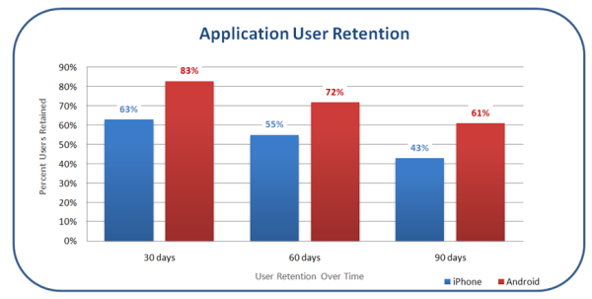
Make part of presentation
App Industry Trends
Carriers
OS
Apps
Analysis
Proposal
Montlake Consulting Group
* Flurry

Slide 25
App Industry Insight
Gradual transition from carrier based app stores to carrier portals within the OS app stores
Industry composed of lots of small companies
Real can leverage its position as a large company with more resources
Carriers
OS
Apps
Analysis
Proposal
Montlake Consulting Group

Slide 26
Analysis
Montlake Consulting Group

Slide 27
Top Prospects
Carriers
OS’s
BlackBerry
iPhone
Android
AT&T
Verizon
Carriers
OS
Apps
Analysis
Proposal
Montlake Consulting Group

Slide 28

T-Mobile & Sprint
Why not T-Mobile?
Low market share
Price sensitive customers
Highest industry churn rate
2nd lowest subscriber growth
Young customers (value conscious), Older customers (mobile minimalists)
Why not Sprint?
Lowest subscriber growth (negative)
High churn
Main target is direct connect users
Poor marketing history with previous smartphones (ex: Palm Pre)
Carriers
OS
Apps
Analysis
Proposal
Montlake Consulting Group

Slide 29
AT&T
Green Light
Huge 3G subscriber growth → but mainly from iPhone device
High market share (2nd highest)
More room to grow in 3G area, less of existing customers already using 3G devices
Red Light
Lower 3G coverage
Competitive advantage is iPhone (not sustainable)
Carriers
OS
Apps
Analysis
Proposal
Montlake Consulting Group

Slide 30
Verizon
Green Light
High 3G penetration → Large captive audience
Highest total & highest 3G subscribers
Lowest churn (14 straight quarters)
Largest 3G coverage
Alignment in value proposition with Rhapsody. “on-the-go”, “coverage everywhere”
Competitive advantage is sustainable (network coverage)
Red Light
Gated access, very controlled → but high quality control
Lower 3G growth → but large 3G share and many new devices coming
Carriers
OS
Apps
Analysis
Proposal
Montlake Consulting Group

Slide 31
Windows Mobile
Why not Windows Mobile?
Eroding competitive advantage as office suite moves to other operating systems
Continually declining market share
Lowest satisfaction rating
Carriers
OS
Apps
Analysis
Proposal
Montlake Consulting Group

Slide 32
BlackBerry RIM
Green Light
Currently has the highest market share
Predicted to maintain highest market share into 2014
BlackBerry users have high disposable income
Red Light
Predicted loss in market share (loss of 7%, from Gartner)
Blackberry users don’t care too much about apps
High enterprise use (may not be appropriate to have music apps on business device)
Blackberry is looking to focus more on mobile productivity & line-of-business applications in the future
Carriers
OS
Apps
Analysis
Proposal
Montlake Consulting Group

Slide 33
iPhone
Green Light:
iPhone’s mobile data traffic has been growing
Worldwide: 43% to 50%
US: 48% to 55%
Decades of experience in retailing (iTunes, iPod, now the App Store)
Possible partnership with Verizon
*70% chance that Apple will launch the iPhone with Verizon in mid 2010.
Rapid expansion in the realm of applications and accessories.
Carriers
OS
Apps
Analysis
Proposal
Montlake Consulting Group
*Gene Munster of Piper Jaffray

Slide 34
iPhone
Red Light:
Rigid development rules → More work for developers, less reward, and less likelihood of future profit and success.
Highest competition in app market
iPhone users tend to have low app usage after initial download
AT&T may charge higher rates for data hogs
A report said that the average iPhone user consumes 10 times the bandwidth of a typical smartphone user.
Carriers
OS
Apps
Analysis
Proposal
Montlake Consulting Group

Slide 35
Android
Green Light
Strong growth and sustained market share
Compatible user behaviors
Android consumers use their applications significantly more frequently than their iPhone counterparts.
Ability to run apps in the background. This feature fits especially with Rhapsody
Android’s mobile data traffic has been growing
Devices have been receiving great reviews
Time magazine has named the Motorola Droid the No. 1 gadget of 2009 (“Gadget of the Year), besting the iPhone 3GS.
Carriers
OS
Apps
Analysis
Proposal
Montlake Consulting Group
* AppleInsider

Slide 36
Android
Red Light
Far behind the iPhone in market share and installed base.
Ability to “run in background” also opens the chance for increased malware attacks
Carriers
OS
Apps
Analysis
Proposal
Montlake Consulting Group

Slide 37
“Typical” Android User
Tend to be adults between 25 and 40 years old
Have higher disposable income.
More tolerant of imperfections in software
More tech savvy and willing to figure out the details of a specific app.
Carriers
OS
Apps
Analysis
Proposal
Montlake Consulting Group
* AppleInsider

Slide 38
Proposal
Montlake Consulting Group

Slide 39
Strategic Recommendations
Make an early push for Android development
Continue efforts on iPhone app
Capture a slice of BlackBerry’s huge customer base
Keep an eye for partnership with Verizon
Focus on Verizon as a carrier
Carriers
OS
Apps
Analysis
Proposal
Montlake Consulting Group

Slide 40
Appendix
MCG Insights
App Industry Snapshot
Paid Apps Information
Free Apps Information
Applications by Platform
Consumer Usage by Platform
Developer by Platform
Average App prices across OS Stores
App Store Sizing
Consolidating the Smartphone Market
The Evolving Smartphone Market
Global Sales by Platform
Global Traffic by Platform
Smartphone Penetration by OS
AdMob Smartphone Requests (Global)
AdMob Smartphone Requests (US)
Satisfaction by OS
Battery Life Improvements
Heap Cycle for Mobile Applications
Apple vs. Android
Montlake Consulting Group

Slide 41
Paid
Back to Index
Make part of presentation
MCG Insights
Get featured as much as possible
Change the app download experience to be more exciting and explanatory from the get go
Longer time trial
Emphasize that Rhapsody gives the user a market that it is easy and LEGAL
Users experience an application purchase surge when first getting their new device.
Lump purchasing “I have already spent $250, I can spend $15 more”
If Rhapsody came preinstalled on a device, that could jumpstart things
Rhapsody is a hard word to spell. Add in misspelling searches with OS app stores
iPod’s success with iTunes has decreased Rhapsody’s success specifically with the iPhone
New devices without Apple brand and iTunes will provide new opportunities
Emphasize easy cancellation, to those weary about subscription.
Three Minute Tour
Montlake Consulting Group

Slide 42
Paid
Back to Index
Make part of presentation
App Industry Snapshot
Themes
Focus moving away from hardware to software
Personalization of software and hardware becoming necessary as various demographics become consumers of smartphone products
Trends towards increased usership of mobile technologies by women, children, and seniors
Hardware improvements centralized around improving efficiency and battery life
Montlake Consulting Group

Slide 43
Paid
Back to Index
Make part of presentation
App Industry Snapshot
Industry
More users will become interested in the operating system their device is running because the applications and services running on a platform will determine how appealing a device will be. Applications and application stores will be the new focal point for high-end devices. (G00166789)
Applications will serve as a way for users to personalize their smart phones (G00166789).
Most consumers will have smart phones, and most smart phones will be able to do just about all the same things. Pre-installed software and applications will thus determine the consumers appeal for a phone (G00166789).
2009/2010 forecast: Apps, touch screens, and consolidation of vendors as recession deepens. Users want more versatile experience w/ global downturn pushing prices down. Shift from hardware to software with apps. Vendors will shrink portfolios and geographic offerings. (G00166789)
Montlake Consulting Group

Slide 44
Paid
Back to Index
Make part of presentation
App Industry Snapshot
Technology/Software
Android will become a bigger part of the OS/software, smartphone picture. It allows for high usability with easy modification by manufacturer. Slightly more personalized than an iPhone for example. (G00171349)
HTC, for example, released new phones, but focused on improving software within the interface. (G00165928)
Bluetooth 3.0 will enable new types of applications and allow mobile devices to communicate in new ways. Possibilities such as potential music download and sharing options. Will increase the functionality of the phone by necessitating less power during usage of applications. (December 2008, Gartner)
Manufacturers waiting for second generation of android before committing to handsets. (G00165928)
Commitment to LTE and 4G networking should improve performance of new mobile software and apps. (G00165064)
Montlake Consulting Group

Slide 45
Paid
Back to Index
Make part of presentation
App Industry Snapshot
Social (G00169899)
The current target demographic for cell phone technologies is men between the ages of 18 and 34. However, they are not the majority of the population and as there is growth in smartphone use, there is growth in other demographics that are interested in this technology.
Potential for new marketing strategies that target women, children, and seniors.
Potentially making platforms more friendly for children and seniors, bigger buttons, more colors and such.
Other demographics such as women and older people will be more involved in this technology and a bigger part of the consumption of these products. Thus, catering their needs/marketing to them will be important.
More personalized phones and software will be released to cater to various demographics.
Montlake Consulting Group

Slide 46
Paid
Back to Index
Make part of presentation
App Industry Snapshot
Thoughts:
Cell phone as a very personal device that contains multiple aspects of your life and is used as a tool to organize and make life more efficient.
By 2015, 18 year olds in developed countries will spend 50% of time using personally programmed devices for life and all its necessities.
Software will be just as, if not more, important than the hardware.
Montlake Consulting Group

Slide 47
Paid
Back to Index
Make part of presentation
Paid Apps
Features
Shazam: Identify songs, free base program with paid upgrade. Also finds related songs.
Wunder Radio: Provides streaming radio (local and internet-based). Saves radio stations. Compatible with Serius.
Pocket Tunes: Streams 16,000+ Stations. Links to iTunes
Montlake Consulting Group

Slide 48
Paid
Back to Index
Make part of presentation
Paid Apps
Downfalls
Shazam: Complaints about adds, slow streaming speed
Wunder Radio: Software crashes, streaming problems
Pocket Tunes: Generally successful, small problems with Sirius connectivity
Montlake Consulting Group

Slide 49
Paid
Back to Index
Make part of presentation
Free Apps
Features
Pandora: Personalized radio stations and access thousands of songs
Slacker Radio: Creates stations based on genre, allows users to save stations
AOL Radio: Accesses thousands of radio stations around the world and supplemented by an online music database
Last FM: Similar to Pandora, also has ability to look up individual
Montlake Consulting Group

Slide 50
Paid
Back to Index
Make part of presentation
Free Apps
Downfalls
Pandora: Significant overlap/repeats and an inability to listen to specific tracks
Slacker Radio: Doesn’t save settings upon exit and doesn’t play while minimized (iPhone)
AOL Radio: Only Mobile on iPhones/iPods and cannot locate specific songs
Last FM: Individual songs are Youtube links and must pay to save favorite songs
Montlake Consulting Group

Slide 51
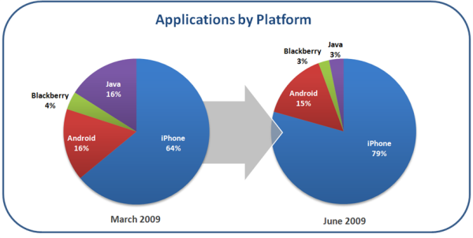
Back to Index
Montlake Consulting Group
* Flurry

Slide 52
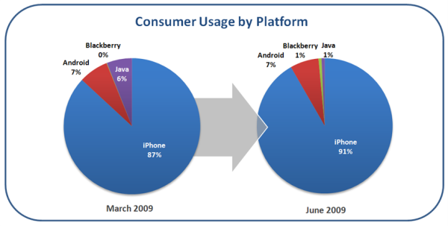
Back to Index
Montlake Consulting Group
* Flurry

Slide 53
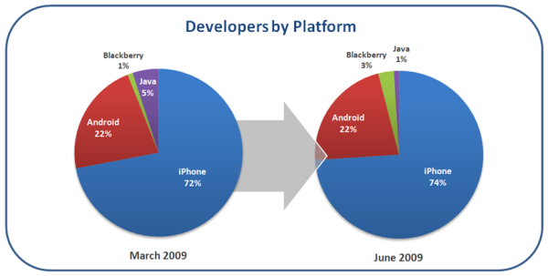
Back to Index
Montlake Consulting Group
* Flurry

Slide 54
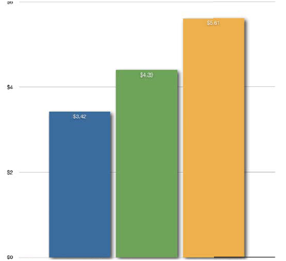
Back to Index
Average App Prices Across Store Publishers (US)
6
5.61
4.39
4
3.42
Appendix
2
0
Apple Google BlackBerry
Montlake Consulting Group
* Distimo

Slide 55
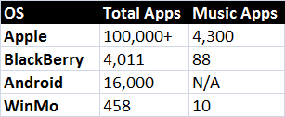
Paid
Back to Index
Make part of presentation
OS App Store Sizing
Montlake Consulting Group

Slide 56
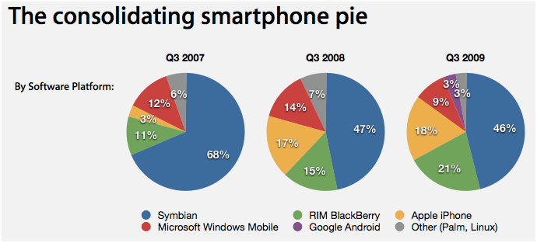
Back to Index
Montlake Consulting Group
* AppleInsider

Slide 57
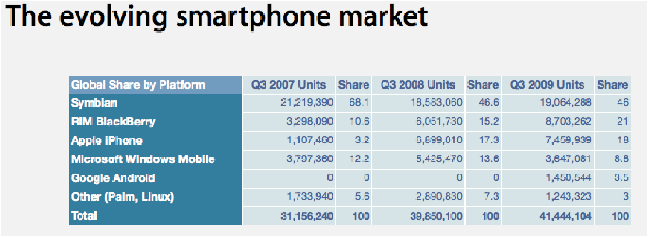
Back to Index
Montlake Consulting Group
* AppleInsider

Slide 58
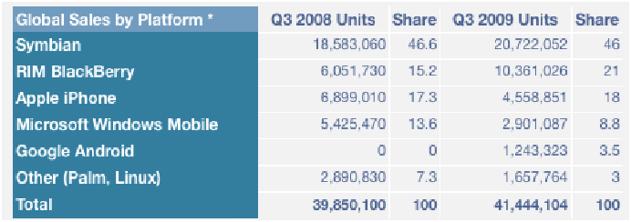
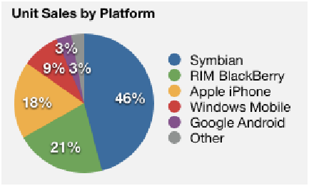
Back to Index
Montlake Consulting Group
* AppleInsider

Slide 59
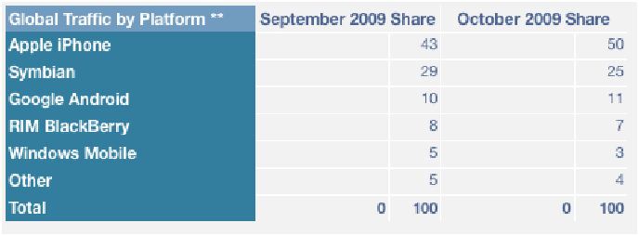
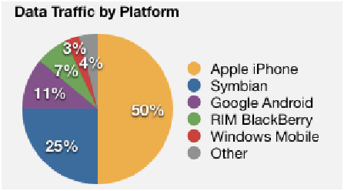
Back to Index
Montlake Consulting Group
* AppleInsider

Slide 60
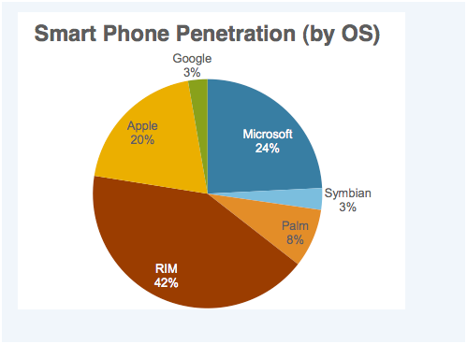
Back to Index
Montlake Consulting Group
* Internet2Go.net

Slide 61
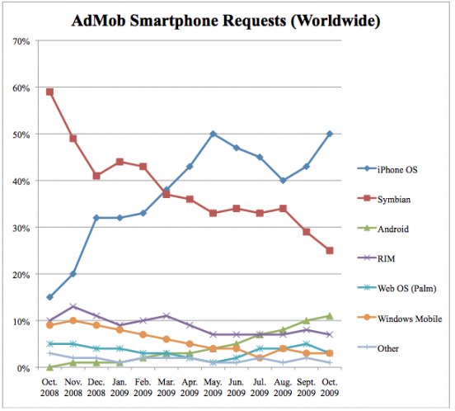
Back to Index
Montlake Consulting Group
* AdMob

Slide 62
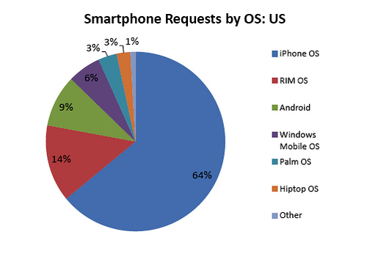
Back to Index
Montlake Consulting Group
* AdMob

Slide 63
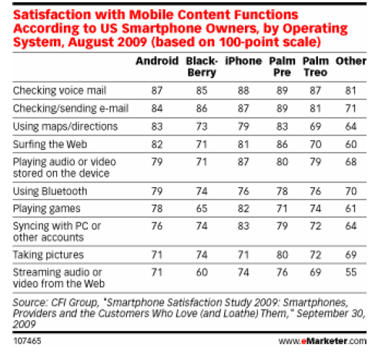
Back to Index
Montlake Consulting Group
* CFI Group

Slide 64
Paid
Back to Index
Make part of presentation
Battery Life Improvements
AM OLED, soon to be available through all major device manufacturers
Samsung [to be released on Sprint and AT&T]: Active matrix organic LED (AM OLED) release in more expensive phone lines. Currently on Impression [AT&T], Behold 2 [T-mobile]. Samsung seems to be the forerunner in AM OLED tech. August 09, Reuters.
http://www.infosyncworld.com/reviews/cell-phones/samsung-behold-ii/10654.html
http://www.reuters.com/article/technologyNews/idUSTRE5754FC20090806
http://www.topnews.in/samsung-phones-come-amoled-technology-2200140
Nokia N85 has AM OLED
Lithium Ion Batteries
Stanford found way to increase Li-ion battery life by 10X. January 08, Cnet.
http://news.cnet.com/A-tenfold-improvement-in-battery-life/2100-1041_3-6226196.html
Cell Phone Battery Life Rankings
By OS and Device, September 09, Cnet.
http://reviews.cnet.com/cell-phone-battery-life-charts/
Montlake Consulting Group

Slide 65
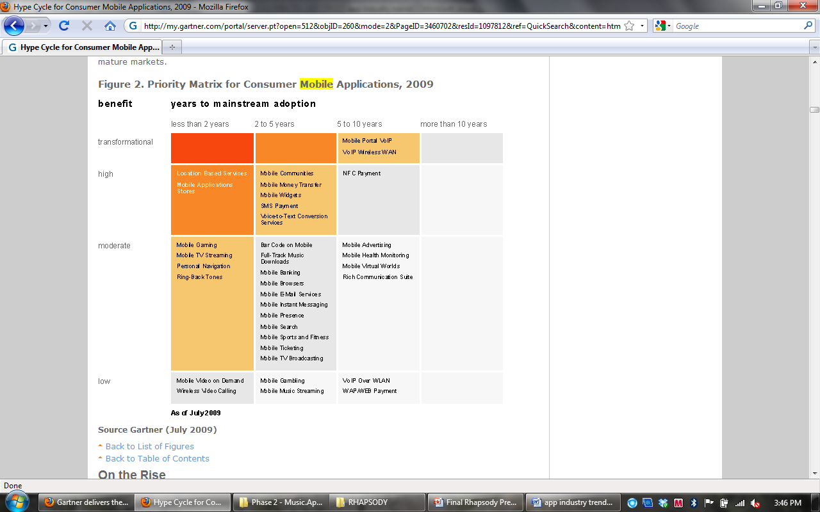
Back to Index
Montlake Consulting Group
* Gartner

Slide 66
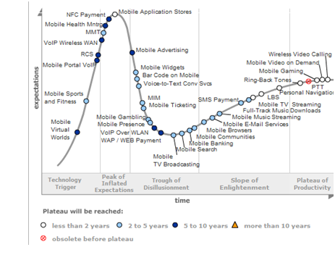
Back to Index
Montlake Consulting Group
* Gartner

Slide 67
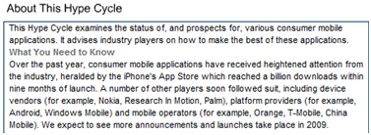
Back to Index
Montlake Consulting Group
* Gartner

Slide 68
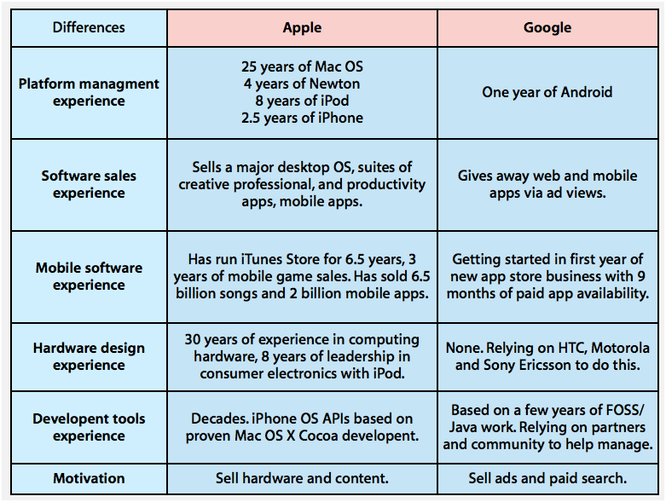
Back to Index
Montlake Consulting Group
* AppleInsider

Slide 69
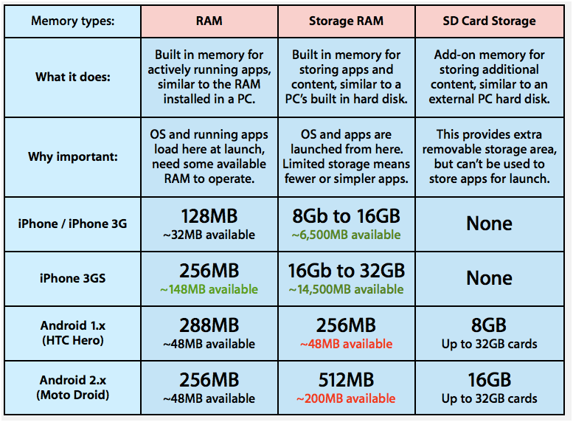
Back to Index
Montlake Consulting Group
* AppleInsider

